Slide 1


Slide 2

Athens Global Azure Bootcamp 2019
Big Data analytics:
Finding diamonds in the rough with Azure
Christos Charmatzis
@T.A. Geoforce
Notes:
ccxcxcx

Slide 3
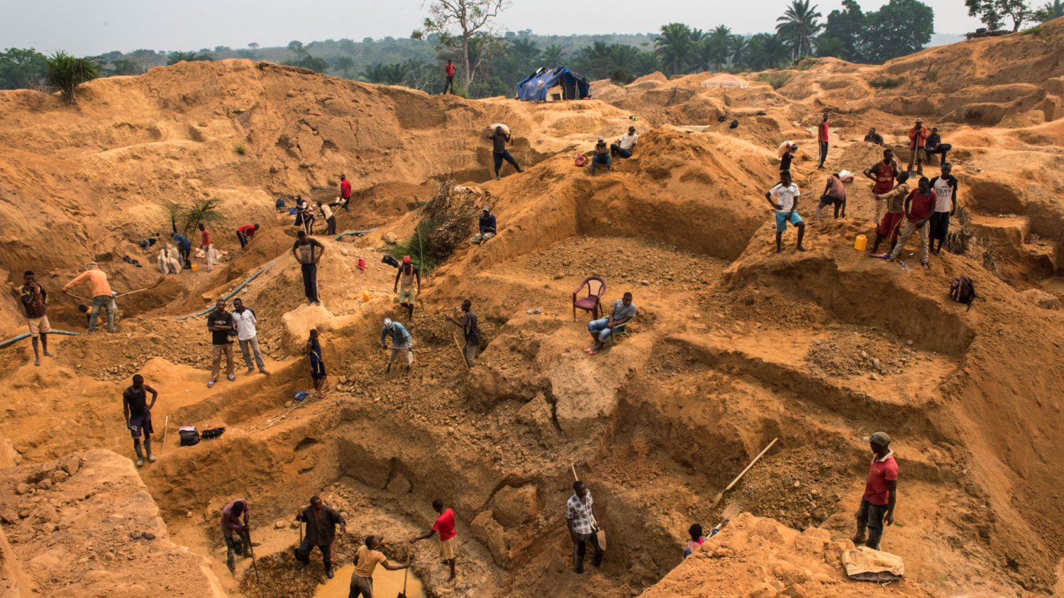
DATA TEAM
Notes:
ccxcxcx

Slide 4
Agenda
Introduction
When we have a Big Data problem
Finding the best solution for our Big Data
Working inside the Data Team
Extract the true value of our data

Slide 5
Introduction
What is Big Data?
"Big Data" is a field that treats ways to analyze, systematically extract information from, or otherwise deal with data sets that are too large or complex to be dealt with by traditional data-processing application software.
Source: Wikipedia
The concept gained momentum in the early 2000s when industry analyst Doug Laney articulated the now-mainstream definition of big data as the three Vs:
Volume
Velocity
Variety

Slide 6
And because everything is relative
What is today’s small (1TB), was yesterday’s big.....
And what is today’s big(100TB) is tomorrow’s small….
(we use 100TB, because is the dataset size of Sort Benchmark competition http://sortbenchmark.org/ )

Slide 7
When we have a Big Data problem?
Example 1
450GB Datasets
Machine (M32ls Instance , 32 VCPU, 256 GiB RAM, 1,024 GiB Storage, ~€2,122.3736/month )
Enterprise Database (e.g. SQL Server)
Aggregation, Statistics, Summaries
Example 2
3TB Datasets
Machine (M32ls Instance , 32 VCPU, 256 GiB RAM, 1,024 GiB Storage, ~€2,122.3736/month )
Enterprise Database (e.g. SQL Server)
Aggregation, Statistics, Summaries
Example 3
10TB Dataset
Aggregation, Statistics, Summaries, Transformations etc
Example 4
450GB Dataset
Machine (M32ls Instance , 32 VCPU, 256 GiB RAM, 1,024 GiB Storage, ~€2,122.3736/month )
Enterprise Database (e.g. SQL Server)
Transformations
STAY WHERE YOU ARE
UPGRADE STORAGE
GO TO THE CLOUD
GO TO THE CLOUD

Slide 8
Big Data Infrastructure comparison
DB in premise
Initial release < 2014
Supported programming languages: almost every programming language
Performance keys: Indexes
!==
Spark Cluster
Initial release > 2014
Supported programming languages: Java, Scala, Python, R, Julia
Performance keys: Partitioning

Slide 9
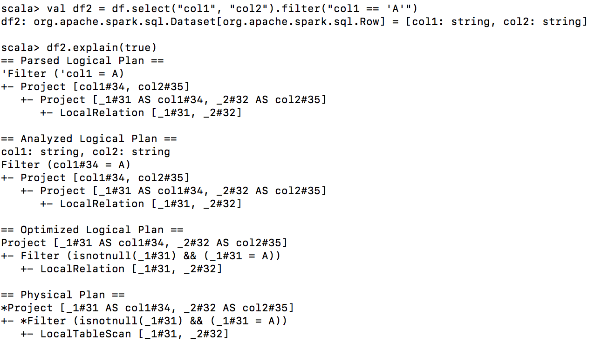
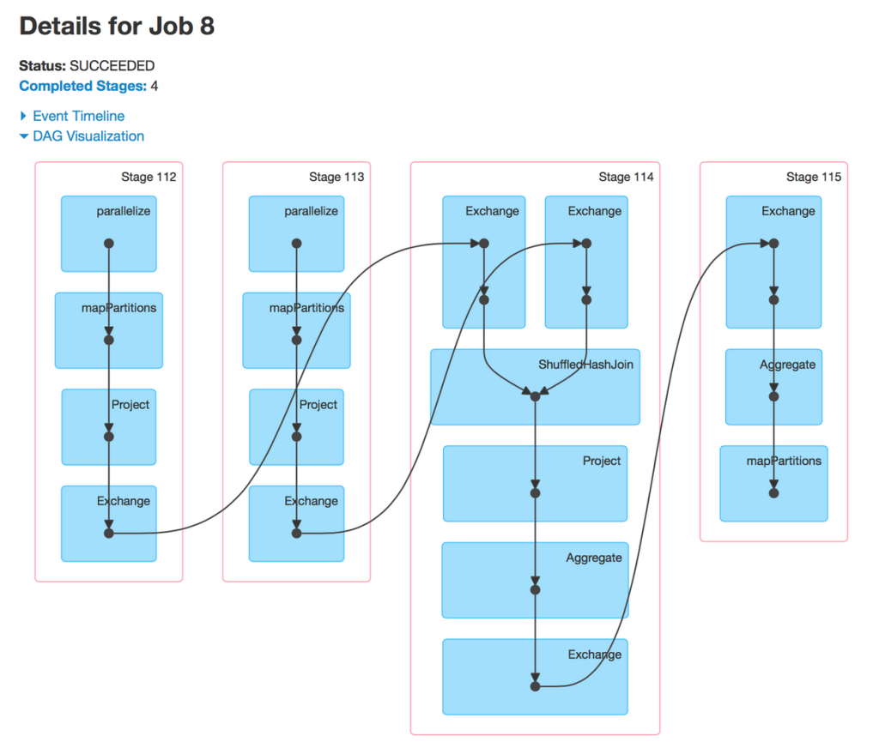
Big Data Performance
In Spark always:
use “df.explain(true)”
Or check the DAG!
Every time a block is changing the data are repartitioning!!!

Slide 10
Finding the best solution for our Big Data problem
Hadoop on a cluster of Azure Virtual Machines
Azure HDInsights (Clusters as-a-service)
Azure Databricks
Azure Data Factory (New & Improved!!!!)
Azure Data Lake Analytics (Queries as-a-service)

Slide 11


Big Data in Azure: Storage
Azure Blob Storage
Object Storage
General purpose (files & workloads)
Azure Data Lake
Hierarchical file system
Optimized for analytics workloads
Azure Data Lake (Gen.2)
Multi-modal storage
Optimized for analytics workloads

Slide 12
Big Data in Azure: Storage
Azure Blob Storage
wasb[s]://containername@accountname.blob.core.windows.net/file.csv
Azure Data Lake
abfs[s]://filesystemname@accountname.dfs.core.windows.net/file.csv
Azure Data Lake (Gen.2)
Endpoint: object store access Blob API using wasb[s]://
Endpoint: file system access ADLS Gen 2 API using abfs[s]://

Slide 13
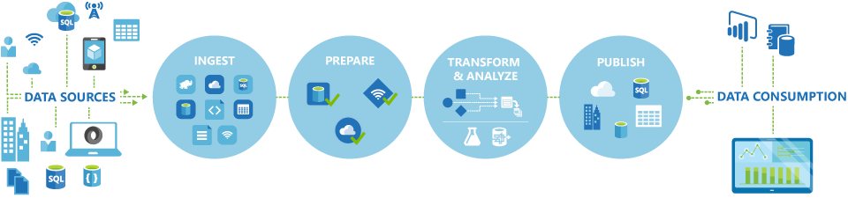
Azure Data Factory
A managed could service for building & operating data pipelines.

Slide 14
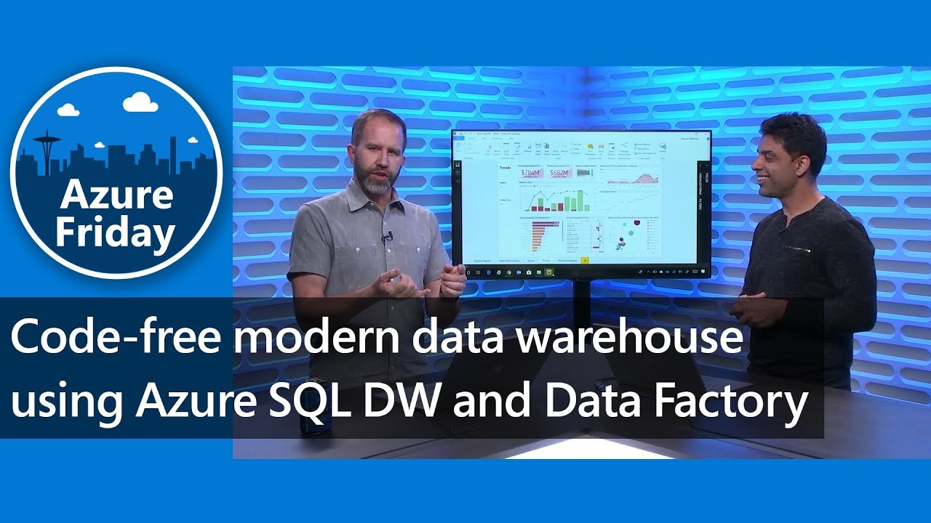
Azure Data Factory
Source: https://channel9.msdn.com

Slide 15
Azure Data Factory (ADF)
DEMO

Slide 16
Why do we need tools like ADF?
85% of the working time is on data wrangling!!!

Slide 17
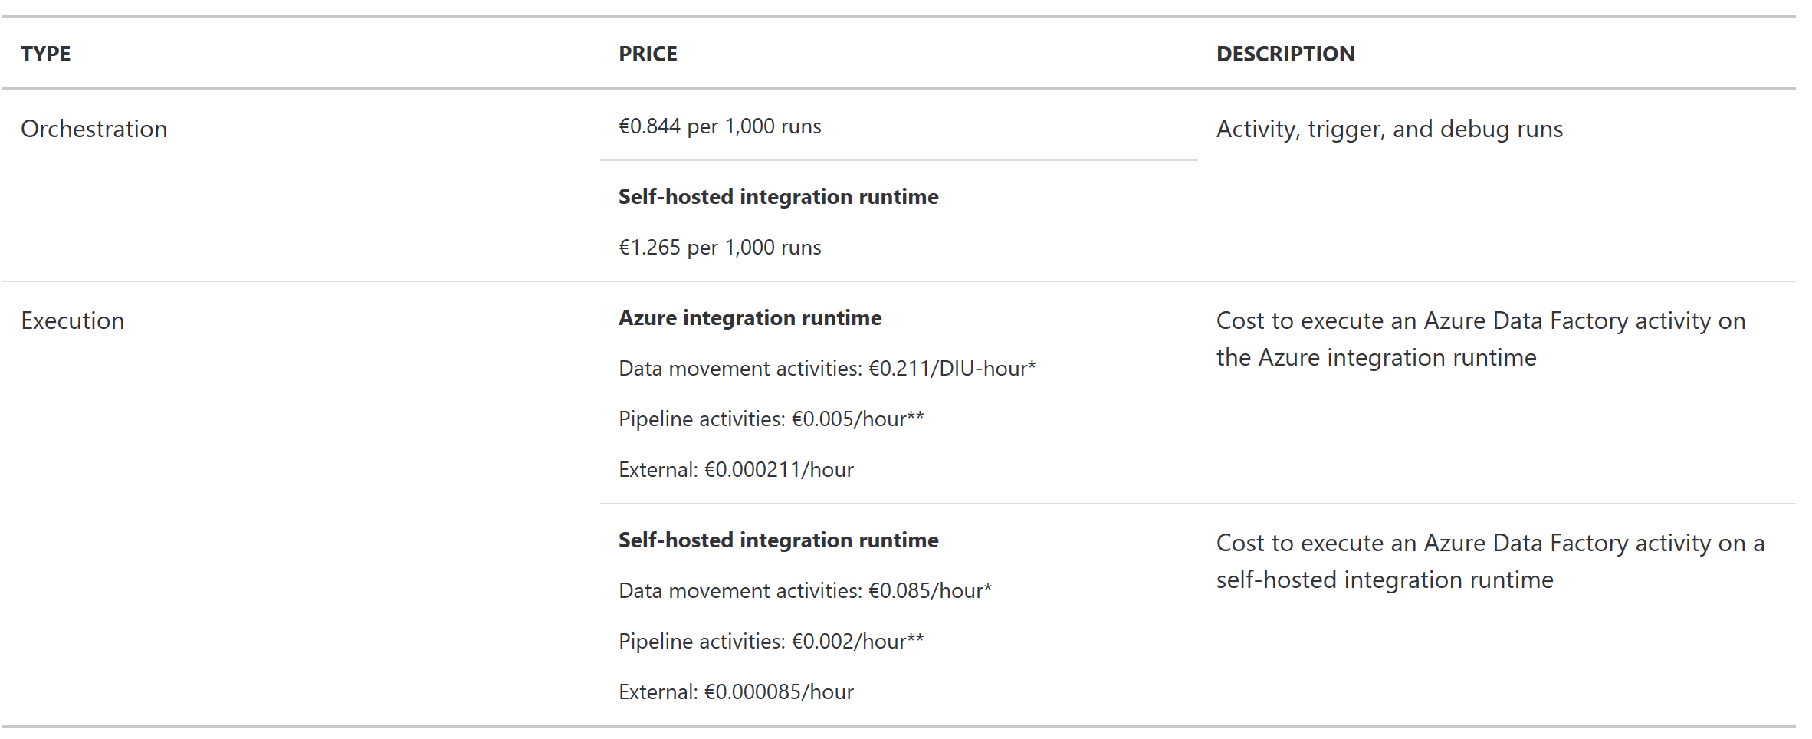
ADF Pricing
https://azure.microsoft.com/en-us/pricing/details/data-factory/
Tip: Look out!!! The data reads and writes are the most expensive in Big Data Analytics

Slide 18

Working inside the Data Team
Yes, there're in a folder, inside a VM, inside John's PC...
We must compare the results with last year's...
Don't we have somewhere that report?
I will run the whole thing, again
No, we have uploaded them in blob storage... I don't remember where?
Somewhere, inside a meeting room….
Rembrandt (1662). The Sampling Officials (Dutch: De Staalmeesters))

Slide 19
Metadata area
With Data comes problems….
With Big Data comes Bigger Problems!!!
Like….
Many datasets
Frequently updates
Many fields
Many users

Slide 20
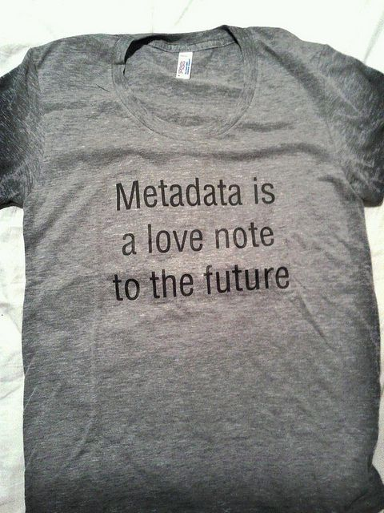
Where do I keep the metadata?
Azure Data Catalogue
DataBricks Delta Lake
Create your own meta-portal
Be aware, always use metadata standards (ISO, Dublin Core, MPEG-7 …)
More info: https://en.wikipedia.org/wiki/Metadata_standard#Available_metadata_standards

Slide 21
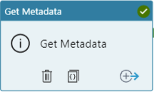
Azure Data Factory Metadata
This activity allows for collecting metadata about Azure Data Factory.
Get Metadata activity supports:
itemName
itemType
Size
Created
lastModified
childItems
contentMD5
Structure
columnCount
exists

Slide 22

Extract real value from the data
Visualize data | Write good experiments | Share results

Slide 23
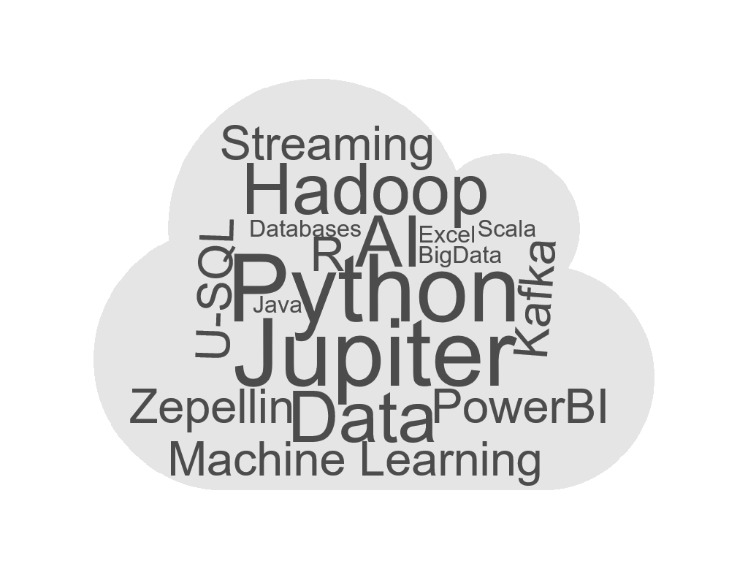
And we just scratched the surface of that…

Slide 24
Conclusions
For ETL projects from in premise to cloud use Azure Data Factory
The size isn’t always the problem in your case
Velocity isn’t only on the code side, you HAVE to know your data
Create METADATA

Slide 25




Thank U
Qs+As
Please evaluate:
http://bit.ly/AAB2019Evaluation

